Slide 1
MANGO DAMAGE SEGMENTATION
BY
PATRICIA ANKUNDA 2301600103
DESIRE KAWALA 230160079
AISHA BABIRYE 2301600101

Slide 2
Introduction
Mangoes are widely consumed but highly vulnerable to diseases.
Manual inspection is slow, subjective, and error-prone.
Goal: Detect and segment diseased regions using deep learning.

Slide 3
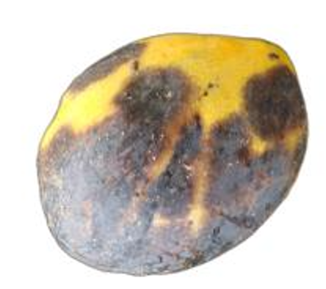
Dataset Description
500 images of diseased mangoes collected using Android phones.
Captured under natural lighting at different orientations.

Slide 4

Preprocessing
Background removal and resizing.
Eliminated corrupt and duplicate images.
Applied augmentation: Brighteness adjustment, rotation and flipping.

Slide 5
Creating Segmentation Masks
• Ground truth masks were generated using unsupervised methods.
• Compared HSV clustering and grayscale clustering.
• Goal: Identify the best approach for accurate mask generation.

Slide 6
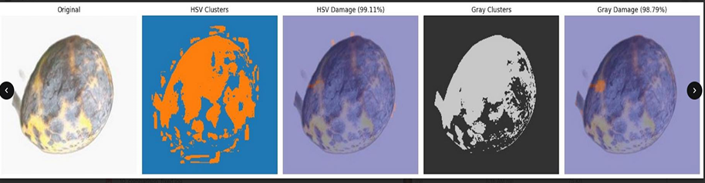
HSV vs Grayscale Segmentation
HSV Clustering
• Detects dark/discolored regions well.
• Highly sensitive to color differences.
• High variance in damage detection.
Grayscale Clustering
• More stable and consistent.
• Less color-sensitive.
• Produced cleaner masks overall.

Slide 7
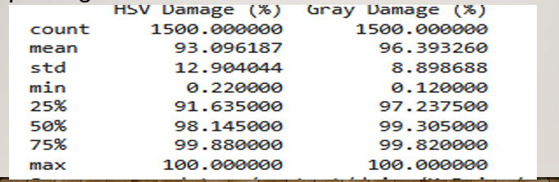
Evaluation Outcome
• The evaluation showed grayscale clustering performed best.
• HSV was too sensitive and inconsistent for mask generation.
• Final decision: Used grayscale masks for training.

Slide 8
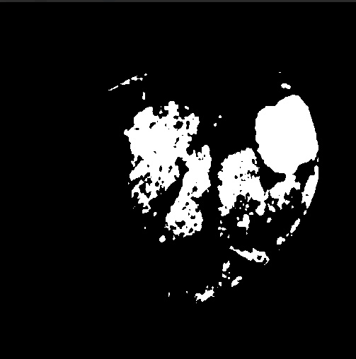
Creating Grayscale Masks
• Used K-means clustering with k = 4.
• Pixels grouped into 4 intensity levels.
• Darkest cluster selected as damaged region.
• Final output
Binary mask (255 = damaged, 0 = healthy)

Slide 9
Model Training Overview
• Models used: U-Net and DeepLabV3.
• Dataset: 500 images + 500 masks.
• Train/Validation split: 80% / 20%.
• Images resized and normalized before training.

Slide 10
Models Used
U-Net Training
Input size: 224x224.
Optimizer: Adam optimizer
Trained for 5 epochs, batch size 8.
DeepLabV3 Training
Backbone: ResNet50.
Optimizer: Adam optimizer (0.001).
Trained for 5 epochs.

Slide 11
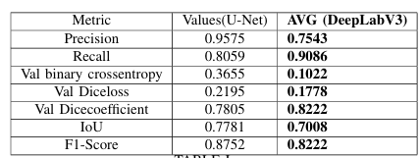
Model Result Comparison

Slide 12
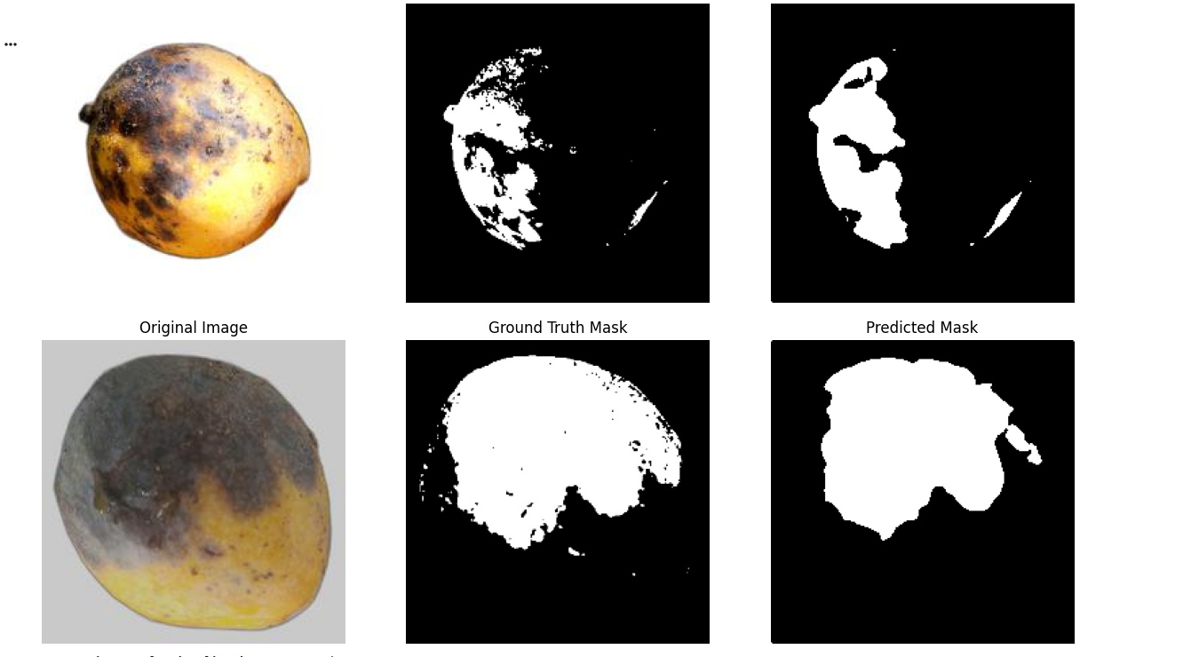
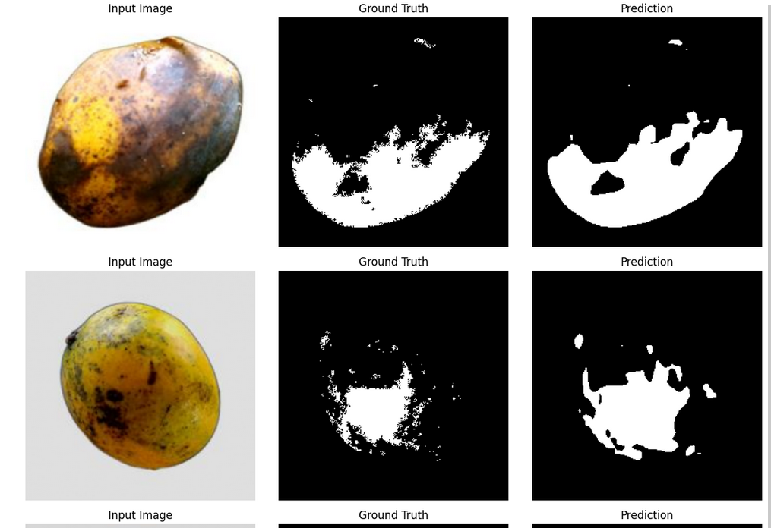
Segmentation visualization results
Results: U-Net
Results: DeepLabV3

Slide 13
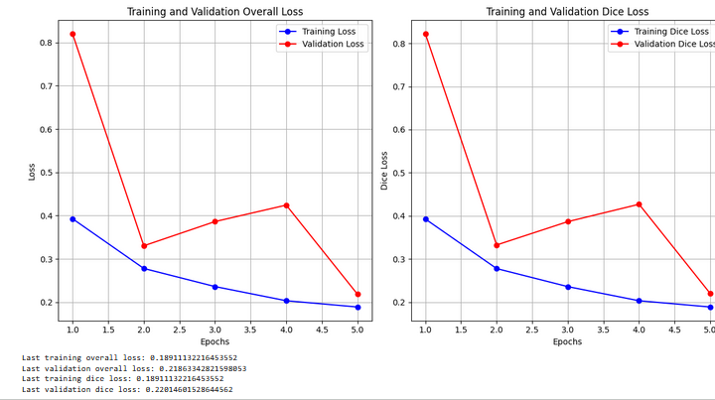
U-Net Visual Results
Good overlap between prediction and ground truth.
• Well-defined lesion boundaries.
• Minimal overfitting observed.

Slide 14
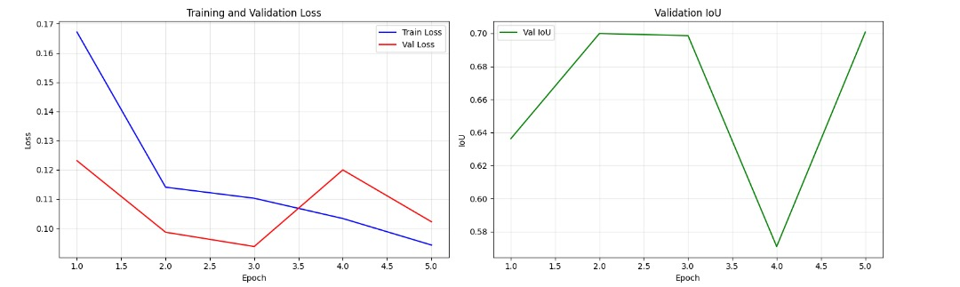
DeepLabV3 Visual Results
• Training and validation loss decrease with slight fluctuations.
• Validation IoU peaks at Epochs 2 and 5 (~0.70).
• Indicates strong generalization and stable training behavior.
• DeepLabV3 maintains consistent segmentation performance across epochs.

Slide 15
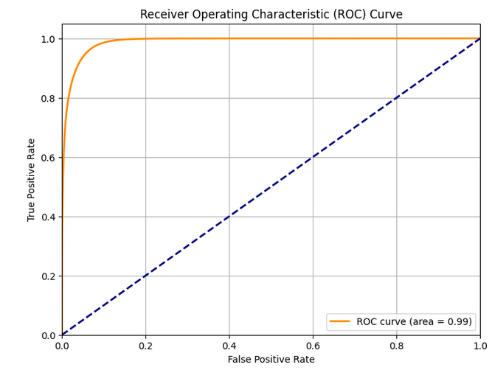
Receiver Operating Characteristic AUC: 0.9886

Slide 16
Model Comparison
DeepLabV3 showed more stable and consistent convergence than U-Net.
Training and validation losses decreased smoothly,
indicating reliable learning.
DeepLabV3 produced higher-quality mask predictions (better Dice and IoU).
U-Net showed a small train–validation gap, but its validation curve
fluctuated more, indicating less stable performance.

Slide 17
Limitations
Limited RAM reduced dataset size and epochs.
Inconsistent natural lighting conditions.
Potential underfitting due to few epochs.

Slide 18
Future Work
Increase dataset size and diversity.
More extensive hyperparameter tuning.
Train for more epochs.
Deploy to mobile platforms.
Extend approach to other fruits.

Slide 19
Conclusion
Deep learning enables accurate segmentation of mango disease.
DeepLabV3 outperformed U-Net overall.
The system is a strong foundation for real-world agricultural AI tools.

